Slide 1

I. Project Introduction
This mobile application project is an e-commerce system developed using Kotlin and Jetpack Compose. It allows users to browse products, manage a shopping cart, place orders, and give feedback. The app uses Firebase Firestore for data storage and Firebase Authentication for user login and registration.

Slide 2

II. Project Goals
Design a modern, responsive e-commerce mobile interface
Implement real-time database operations using Firebase Firestore
Allow users to interact with products: search, add to cart, and order
Support multimedia feedback with image and video uploads
Ensure data security through Firebase Authentication

Slide 3


III. Technologies Used
Kotlin + Jetpack Compose: UI design and app logic
Firebase Firestore: Cloud NoSQL

Slide 4

IV. Key Features
User authentication: login and register
Product list with search and category filter
Shopping cart management (add, remove, update quantity)
Checkout with address and payment method selection
View order history
Submit and view feedback, with support for images and videos

Slide 5
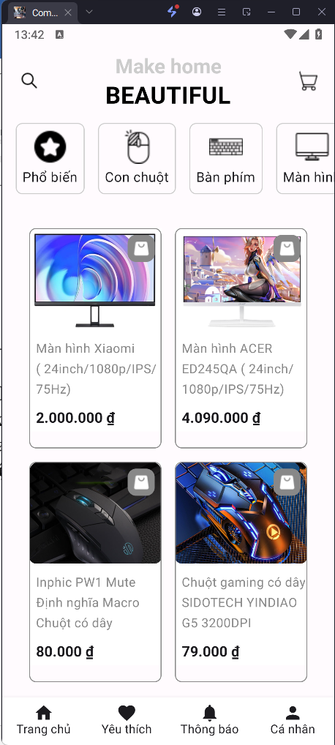
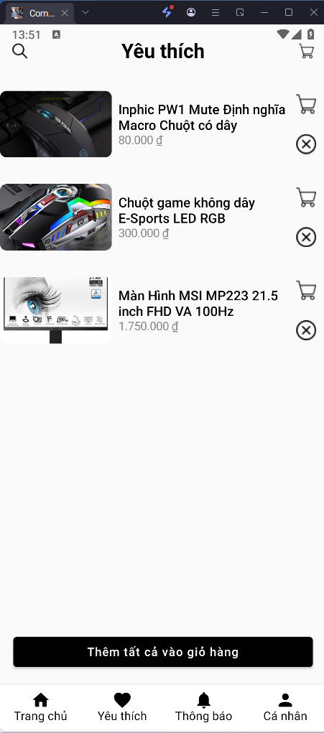
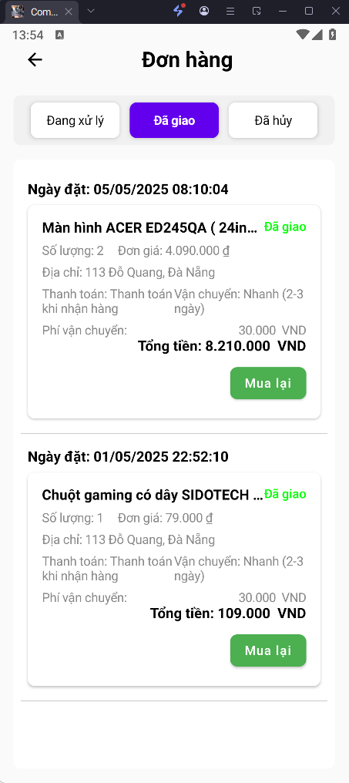
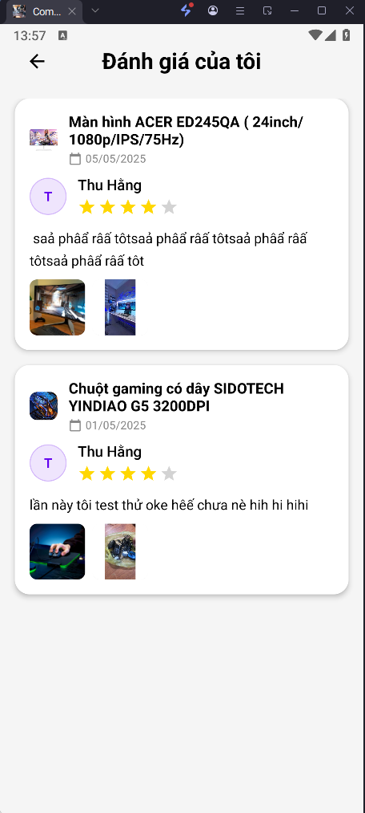
V. App UI Overview

Slide 6
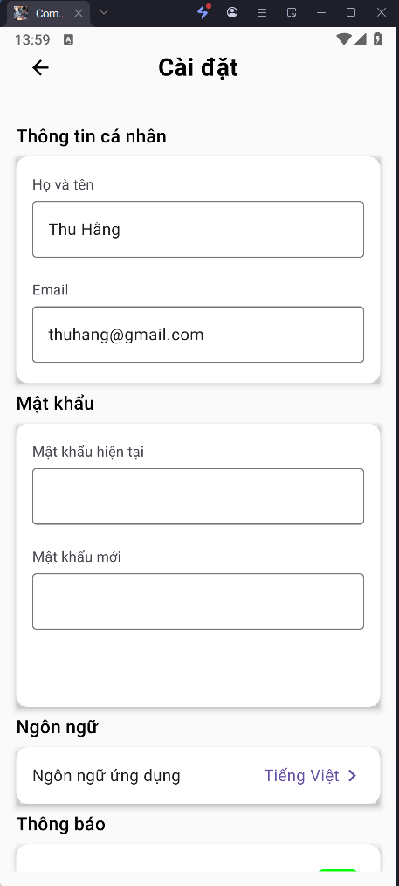
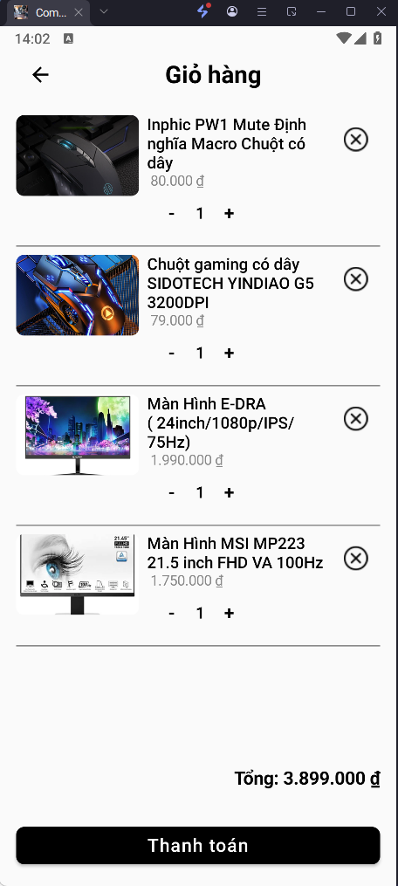
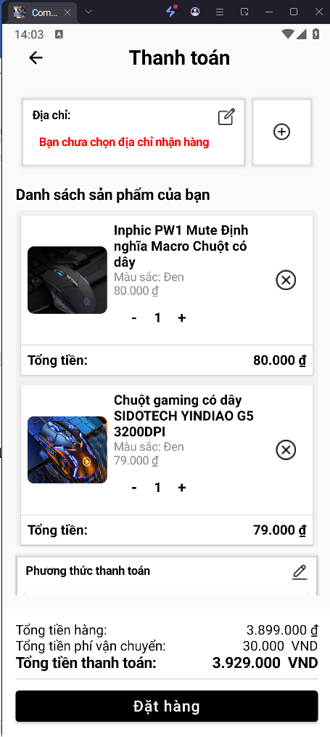
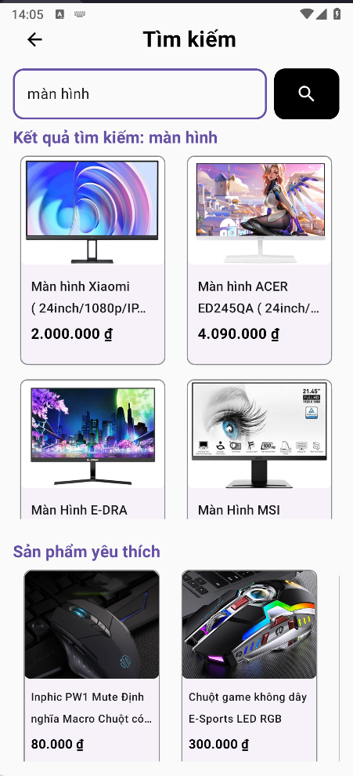
V. App UI Overview

